Slide 1

CSE325 OPERATING SYSTEMS LABORATORY
Lecture #0
The kick start session
Notes:
‹#›

Slide 2
Course details
LTP – 0 0 2 [Two Practicals/week]
Credit – 1
Notes:
‹#›

Slide 3
Assessment/Evaluation Scheme
Attendance: 5%
CAP: 45%
ETP: 50%
Notes:
‹#›

Slide 4
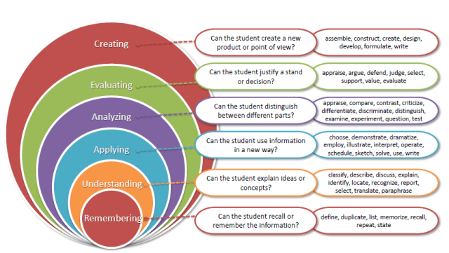
Revised Bloom’s Taxonomy
Notes:
‹#›

Slide 5
Course outcomes
Through this course students should be able to:
CO1 :: Understand and Implement shell programming to do basic OS tasks.
CO2 :: Analyze various system calls in order to utilize them effectively.
CO3 :: Demonstrate various process management related tasks.
CO4 :: Develop multithreaded processes using pthread library.
CO5 :: Apply the various synchronization problems to ensure data consistency using mutex and semaphores.
CO6 :: Analyze different inter process communication strategies.
Notes:
‹#›

Slide 6
Program Outcomes
PO1 Engineering knowledge: Apply the knowledge of mathematics, science, engineering fundamentals, and an engineering specialization to the solution of complex engineering problems.
PO2 Problem analysis::Identify, formulate, research literature, and analyze complex engineering problems reaching substantiated conclusions using first principles of mathematics, natural sciences, and engineering sciences.
PO3 Design/development of solutions::Design solutions for complex engineering problems and design system components or processes that meet the specified needs with appropriate consideration for the public health and safety, and the cultural, societal, and environmental considerations.
PO4 Conduct investigations of complex problems::Use research-based knowledge and research methods including design of experiments, analysis and interpretation of data, and synthesis of the information to provide valid conclusions.
Notes:
‹#›

Slide 7
Program Outcomes
PO5 Modern tool usage::Create, select, and apply appropriate techniques, resources, and modern engineering and IT tools including prediction and modeling to complex engineering activities with an understanding of the limitations.
PO6 The engineer and society::Apply reasoning informed by the contextual knowledge to assess societal, health, safety, legal and cultural issues and the consequent responsibilities relevant to the professional engineering practice.
PO7 Environment and sustainability::Understand the impact of the professional engineering solutions in societal and environmental contexts, and demonstrate the knowledge of, and need for sustainable development.
PO8 Ethics::Apply ethical principles and commit to professional ethics and responsibilities and norms of the engineering practice.
PO9 Individual and team work::Function effectively as an individual, and as a member or leader in diverse teams, and in multidisciplinary settings.
Notes:
‹#›

Slide 8
Program Outcomes
PO10 Communication::Communicate effectively on complex engineering activities with the engineering community and with society at large, such as, being able to comprehend and write effective reports and design documentation, make effective presentations, and give and receive clear instructions.
PO11 Project management and finance::Demonstrate knowledge and understanding of the engineering, management principles and apply the same to one’s own work, as a member or a leader in a team, manage projects efficiently in respective disciplines and multidisciplinary environments after consideration of economic and financial factors.
PO12 Life-long learning::Recognize the need for, and have the preparation and ability to engage in independent and life-long learning in the broadest context of technological change.
PO13 Competitive Skills::Ability to compete in national and international technical events and building the competitive spirit alongwith having a good digital footprint.
Notes:
‹#›

Slide 9
Course contents
Introduction to Linux
Basic Linux Commands: Is, cat, man, cd, touch, cp, mv, rmdir, mkdir, rm, chmod, pwd
System Calls: Read, Write, Open
lseek
Notes:
‹#›

Slide 10
Course contents
Shell programming
Variables
Standard input/output redirection
Shell arithmetic
Flow control and decision making
Notes:
‹#›

Slide 11
Course contents
Process creation and threading
Creating processes
Process duplication using fork()
Creating threads using pthread
Environment variables
Replacing process image using execlp
Notes:
‹#›

Slide 12
Course contents
Synchronization
Synchronization with Mutexes
Synchronization with semaphores
Race Condition
Notes:
‹#›

Slide 13
Course contents
Inter-process communication
Pipes, popen and pclose functions
Stream pipes, passing file descriptors
Shared memory
Message passing
Remote Procedure calls
Notes:
‹#›

Slide 14
EDU-REV Initiative
COURSE TITLE :Hands-on Introduction to Linux Commands and Shell Scripting
COURSE LINK:Hands-on Introduction to Linux Commands and Shell Scripting | Coursera
BENEFIT: One CA exemption for this MOOC course from Coursera
One CA exemption for this MOOC course from Coursera

Slide 15
Text & Reference Books
Text Books:
BEGINING LINUX PROGRAMMING by NEIL MATHEW & RICHARD STONES, WILEY
References:
OPERATING SYSTEM CONCEPTS By ABRAHAM SILBERSCHATZ, GALVIN, WILEY
UNIX CONCEPTS AND APPLICATIONS By SUMITABHA DAS, Tata Mcgraw Hill, India
Notes:
‹#›

Slide 17
Education Revolution 25th Academic Session of LPU

Slide 18
Why EDU-Revolution!!!
Career Readiness
Enhance Real World Skills
Promote Innovation and Creativity
Foster Industry Relations
Develop Entrepreneurial Mindset
Increase Student Engagement and Motivation
Promote Lifelong Learning

Slide 19
Education Revolution: an approach that encourages…
Gamified Learning with AI focus - Learning Outside Classroom
Revenue Generation by Students
Career (not just degree)
Students in Decision Making

Slide 20
Pillar I: Gamified Learning with AI focus
50% grades outside the classroom
50% Learning outside the classroom
50% attendance outside the classroom
Formula: 50-50-50
Techniques of Learning Outside the Classroom
Projects
Technical Competitions & Hackathons
Social Media Presence
Recognition of Prior Learning
Paid Internship
Recruitment/Competitive/ Eligibility Examination
NPTEL/MOOCs
Community Service
Publications/Patents/ Copyrights

Slide 21
Projects
Technical Competitions & Hackathons
Social Media Presence
Recognition of Prior Learning
Paid Internship
Recruitment/Competitive/ Eligibility Examination
NPTEL/MOOCs
Community Service
Publications/Patents/ Copyrights
School to add relevant school specific examples of each category which students have taken in the past or students may take up in the coming term as mentioned above

Slide 22
Gamified Learning: Benefits
Course Exemption
Grade Upgradation
No Pen-Paper based Evaluation
Attendance Relaxation
Duty Leaves
Value Addition in Academic Transcript

Slide 23
Pillar II: Revenue Generation
Where would Revenue Generation come from?
Industry/field consultancy projects
Freelancing activities
Paid internships
Establishing start- ups and entrepreneurial venture
Through University support:
Earn while Learn opportunities
Incentives for Publication/Patent/Copyright
You should be able to generate at least 50 % age of your semester fee every semester

Slide 24
Pillar II: Revenue Generation
Course Exemption/Grade upgradation
Student Centric Revenue Generation
Duty Leave
Important Points:
Submit authentic information only
Student must submit a detailed proposal outlining:
Revenue Model
Market Feasibility
Execution Strategy
Financial Projections
Earn exemptions from your revenue generation endeavors
Earn Academic benefits on revenues above 50,000 (in 6 months)

Slide 25
Pillar II: Revenue Generation School Specific Sucess Stories
(Highlighting maximum revenue generated and sustainable revenue generation projects)

Slide 26
"Your Journey, Your Choice: Build, Serve, or Study for Tomorrow!"
Corporate Jobs
Government
Jobs
Higher Studies
Entrepreneurship
Research
Study Abroad

Slide 27
Career Pathways are at the core of our academic framework.
Curriculum is strategically designed to align with needs and requirements of each career pathway.
From technical proficiency to soft skills, the curriculum is tailored to develop a well-rounded professional ready for competitive market as per the chosen pathway.

Slide 28
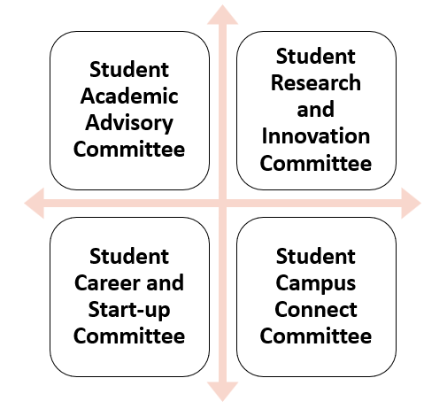
Pillar IV: Students in Decision Making
Committees under Student Education Revolution Board
We bring numerous ideas every year; but now, at least 20% of these ideas should originate from students themselves in all categories like academics, placements, research, entrepreneurship, etc.

Slide 29
Pillar IV: Students in Decision Making A platform to bring the Change
Research Area
Projects to Pursue
Funding opportunities
Identification of Real World Problems
Academic Benefits
Curriculum
Content
New Teaching Methods
New Evaluation Methods
Academic Benefits
National/International Internship
Bring New companies
International Placement opportunities
Entrepreneural Areas
Academic Benefits
Social Media Presence of Schools
Social Media Campaigns
Self Promotion
Academic Benefits

